Slide 1

Home Loan Default Predictions

Slide 2
Agenda
Data Science Lifecycle
Project Overview
Process Overview
Data and EDA
Modeling
Model Evaluation
Recommendations

Slide 3
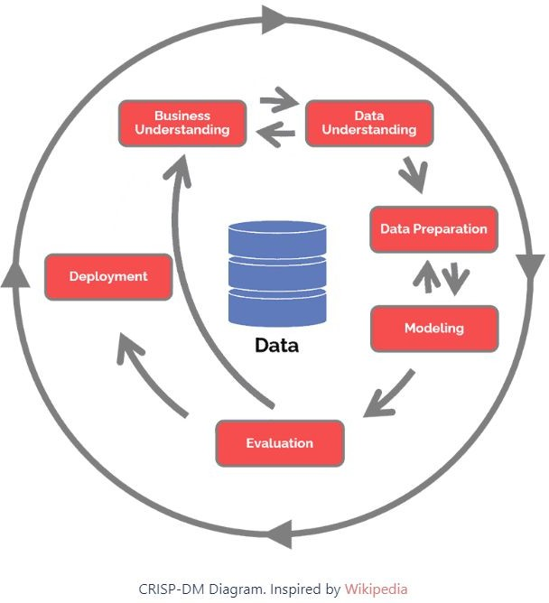
Data Science Lifecycle

Slide 4
Project Overview
Business Challenge:
At present, the home loan application process relies heavily on manual procedures, resulting in a significant delay of 2-3 days before applicants receive notification of their application status.
Business Goal:
Our aim is to streamline and expedite the notification process for loan applicants, reducing the time from days to mere seconds.
Proposed Solution:
Drawing insights from historical data, we aim to leverage machine learning techniques to predict the loan status of prospective borrowers. By doing so, we anticipate a substantial reduction in the time it takes for applicants to receive their application statuses.

Slide 5





Process Overview / Solution
Prospective applicants can conveniently submit their loan applications through any device by providing relevant information such as marital status and income.
Upon submission, our machine learning model, trained on historical data, will promptly evaluate the application.
Within seconds, the applicant will receive a real-time prediction on their device, indicating whether their application has been accepted or declined.

Slide 6
Data and EDA
The number of records – 614
The number of columns – 13
The number of numerical columns – 5
The number of categorical columns – 8
Target/Loan Status – Y (422) vs N (192)
EDA in jupyter notebook

Slide 7
Modeling
Data Preprocessing: Handled missing values, encoded categorical features, and standardized numerical data.
Model Training: Employed multiple classifiers and performed hyperparameter tuning using GridSearchCV.
Best Model Selection: Determined the best model based on F1 score and deployed it for real-time loan status prediction.

Slide 8
Model Evaluation
Employed 6 different classifier algorithms on this sample data with some hyper-parametric tuning using GridsearchCV.
From the sample data provided found that the Best model based on F1 score was Logistic Regression
have performed well with the accuracy of 83.9%
AutoML
Bespoke ML

Slide 9
Recommendations
From this small dataset found that Linear Regression works better than other models.
Need to train the model with more data to improvise the prediction accuracy.
We understand/know exactly what went in, how it went in and what algorithm was used to achieve the objective
Less time training (works in our favor if we train and predict in real time – maybe not applicable in this use case)
Thank You

